Slide 1
PHARMACEUTICAL INDUSTRY
The Cash Cows
Notes:
Rida

Slide 2

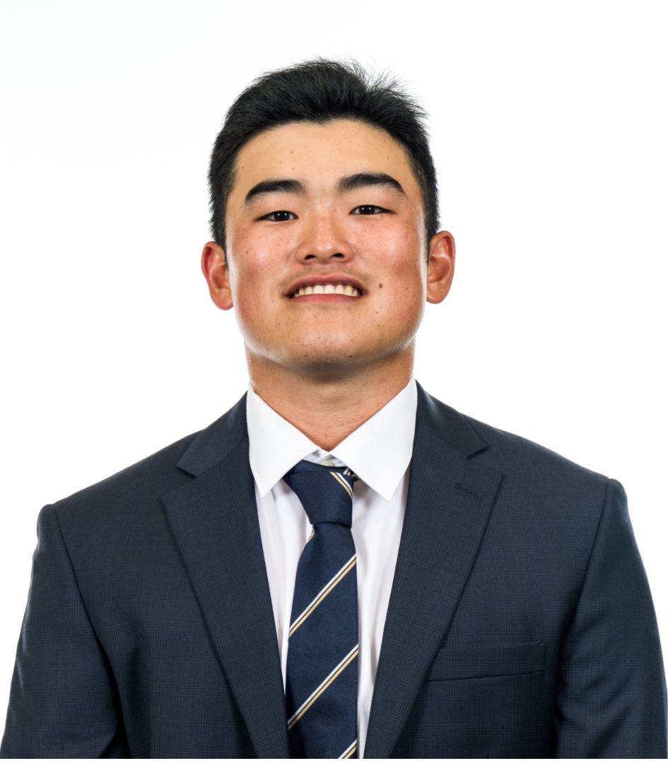


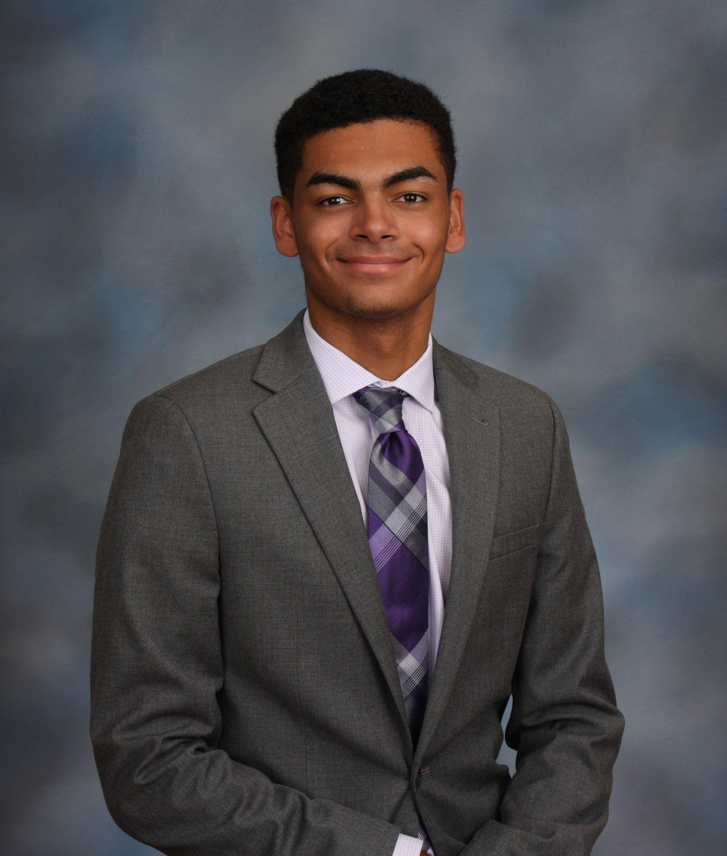
INTRODUCTIONS
Brody Rhodes
Pia Ghosh
Hiroshi Tai
Rida Merani
Nelson Tate
Notes:
Everyone

Slide 3
AGENDA
01
04
02
05
03
06
INDUSTRY BACKGROUND
BRISTOL MYERS
PFIZER
COMPARISONS
MERCK
OUR PICK
Notes:
Rida

Slide 4
01
INDUSTRY BACKGROUND
Notes:
Brody

Slide 5
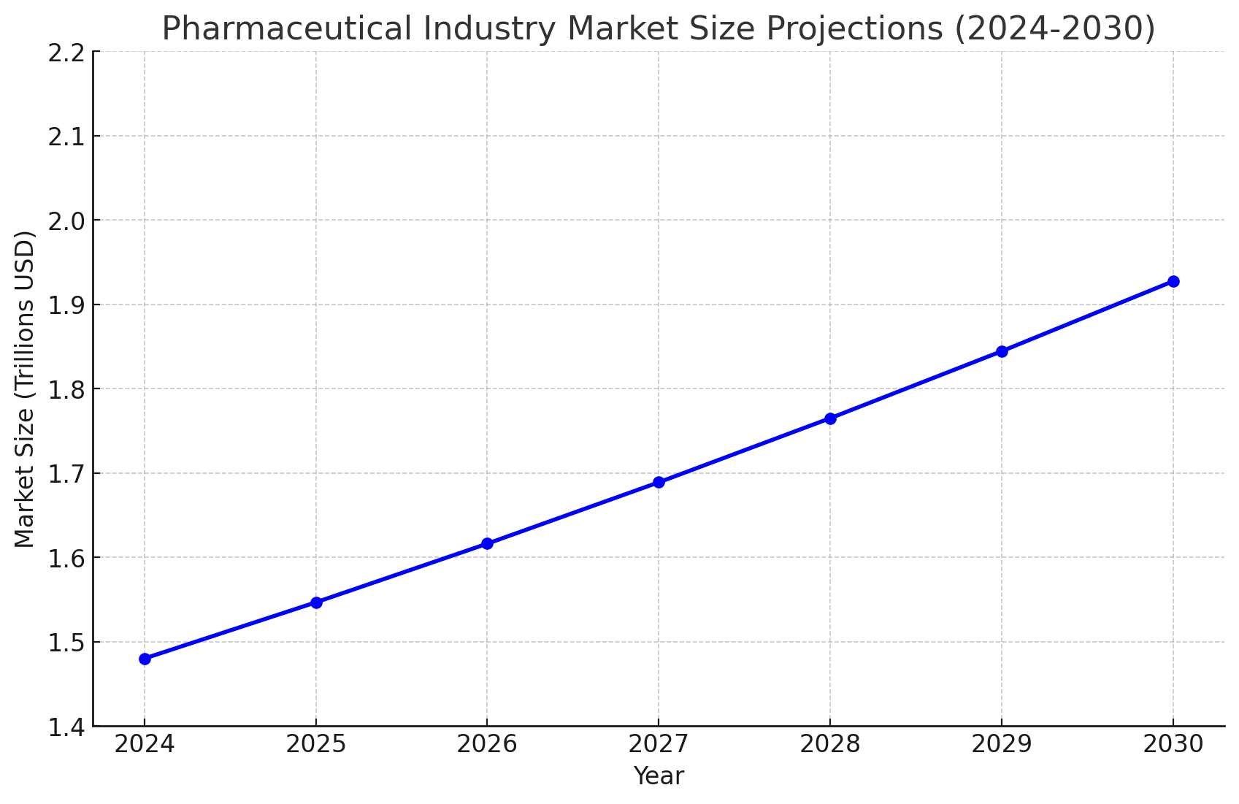
INDUSTRY BACKGROUND
Global Market Value - $1.48 Trillion
By 2030 - $1.92 Trillion
CAGR - 4.5 %

Slide 6

INDUSTRY BACKGROUND
Patent - a government authority or license conferring a right or title for a set period, especially the sole right to exclude others from making, using, or selling an invention.
Impact - grant exclusive rights to companies & allow them to recoup R&D investments and fund future research but can also lead to high drug prices and market monopolies impacting patients
Notes:
Gave own slide to emphasize its importance in this industry. Puts an emphasis on innovation for example Novo Nordisk with Ozempic

Slide 7

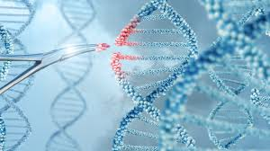

INDUSTRY TRENDS
AI Integration
Expansion
New Regulations
Speeding up data analysis
Efficiency in R&D and clinical trials
Gene and cell therapies
Weight management
Medicare through the Inflation Reduction Act
Notes:
AI integration - Speeding up data analysis and the overall efficiency of things like R&D and clinical trials so that the company can do these things faster and get ahead
Expansion - Gene and cell therapy treatments
Then highlight weight management (ozempic) personally know multiple people on it
Regulations - Medicare now has an expanded ability to negotiate drug prices under the inflation reduction act, this act will likely affect many best selling drugs these companies have

Slide 8
STRENGTHS AND WEAKNESSES
Strengths
Weaknesses
Life Saving Products
Strict Regulations
Economic Driver
High Costs and long timelines
Dependance on Patents
Public Perception
Notes:
Strengths
Obviously the pharma saves tons of lives every day
Strict regulations to get products into the market so people can trust that what they are taking works and will not have a bigger negative effect on them in the long run
Huge economic driver in certain regions with high pharma activity

Slide 9
02
PFIZER
Notes:
Rida

Slide 10
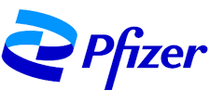
Ticker: PFE
Pfizer Inc. is a leading global pharmaceutical and biotechnology company focused on developing and delivering innovative medicines and vaccines. With a diverse portfolio that addresses various therapeutic areas, including oncology, immunology, and infectious diseases, Pfizer is committed to improving patient health worldwide.
Location: New York City
History: Founded in 1849 by Charles Pfizer
Market Cap: $161.61B

Slide 11
R&D Investments
Recent Developments
The percentage of revenue allocated for Research and Development can indicate potential growth, innovation, and long-term success.
Pfizer showcases significant scientific advancements in respiratory and infectious diseases.
US FDA approves multiple Pfizer vaccines for treatments regarding adults and adolescents.
Pfizer committed $10.58B to R&D in 2023, about 13.5% of their revenue.

Slide 12
Stock Price: $28.52
PEG Ratio: 0.99
Profit Margin: 25.2%
Pfizer’s 52-week range is
25.20 - 31.24.
Pfizer’s PEG Ratio indicates that the stock is fairly valued.
The profit margin is markedly higher than Q2. Margins are boosted by patented products in this industry.
P/E Ratio: 38.03
EBITDA: $18.39B
Q3 Revenue: $17.73B
The P/E ratio is above 30, showing high growth and earnings expectations.
Displays Pfizer’s enormous operational efficiency and performance alongside financial health.
Illustrates how active the company is and aids in predicting future growth.

Slide 13
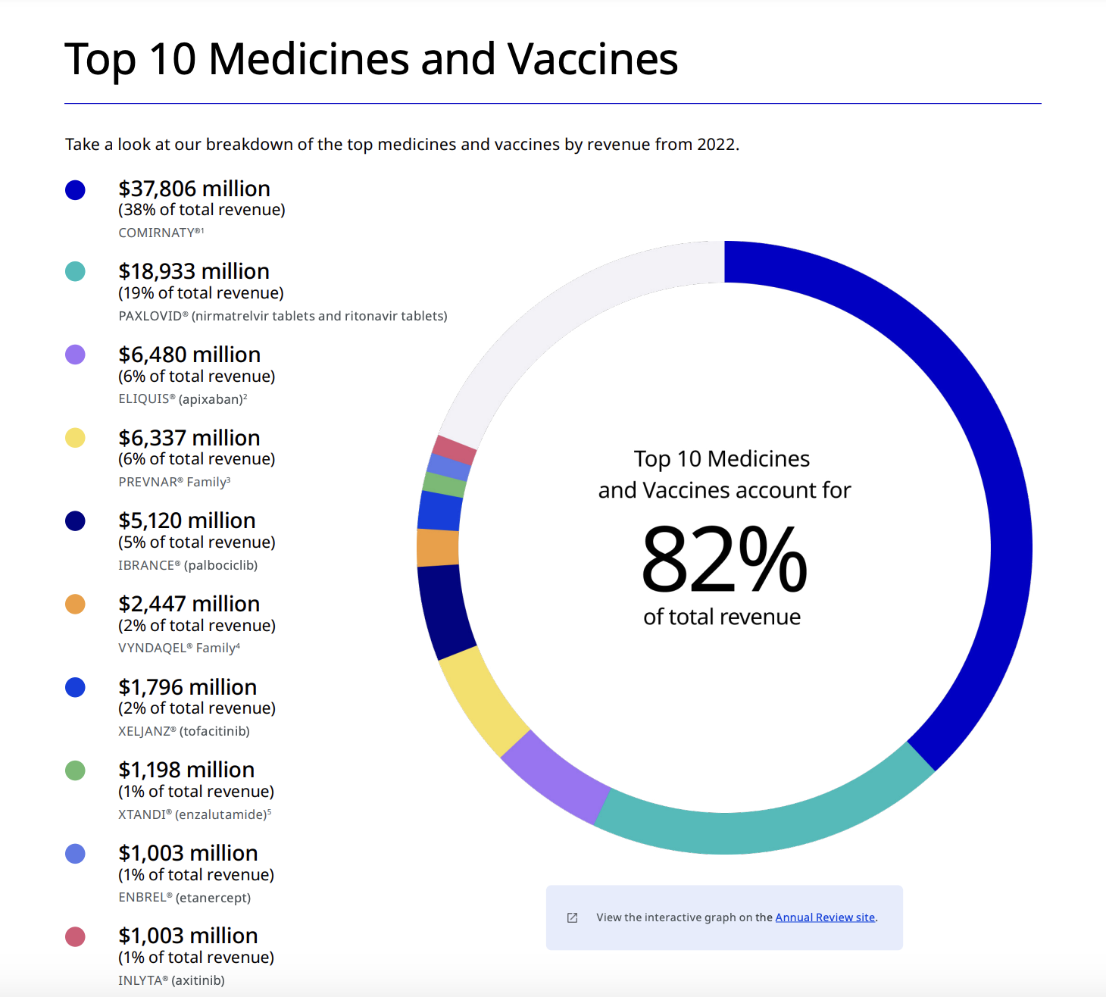

Slide 14
03
MERCK
Notes:
Hiroshi

Slide 15

Ticker: MRK
Merck & Co., Inc. is a leading global healthcare company recognized for its innovative pharmaceuticals and vaccines, with a strong focus on oncology, vaccines, infectious diseases, and cardiovascular health. What sets Merck apart from other pharmaceutical companies is its commitment to extensive research and development, which is exemplified by its robust pipeline aimed at addressing unmet medical needs, along with a strong emphasis on sustainable practices and access to medicines.
Location: Rahway, NJ
History: Founded in 1668 in Germany
Market Cap: $265.72B

Slide 16
Business Model
Recent Developments
Heavy R&D investments in new drugs & vaccines - $30.5B for 2023
Strategic partnerships with governments, universities, and other firms
Prioritize high-value special medications in oncology & immunizations to gain better demand and margins
Developed Gardasil which protects against HPV
Formulated Keytruda, an immunotherapy drug that treats forms of cancer
Multiple R&D centers worldwide - Boston, Ireland, Singapore, etc.
100+ R&D Programs

Slide 17
Stock Price: $104.3
PEG Ratio: 1.55
Profit Margin: 18.9%
Pfizer’s 52-week range is
99.80 - 134.63.
.
Merck’s PEG Ratio indicates that the stock valuation is aligned closely with its growth prospects.
Solid return on its revenue base. It reflects Merck’s strong product mix such as Oncology and Vaccines.
P/E Ratio: 19.2
EBITDA: $20.1B
Q3 Revenue: $16.7B
The P/E ratio is low, showing that it could be undervalued.
Strong growth from consistent focus on high margin products and strategic R&D investments.
4% growth from previous year driven by strong sales from Keytruda and Gardasil.

Slide 18
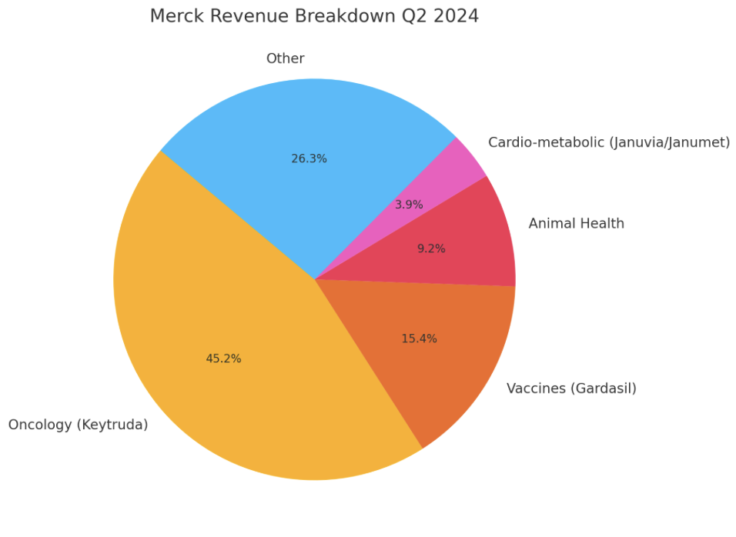
Notes:
Other includes 3rd party manufacturing services, revenue from out-licensed products and partnerships or manufacturing agreements.
Largest portion is from sale of pharmaceuticals
Sale of Vaccines like Gardasil
Animal health

Slide 19
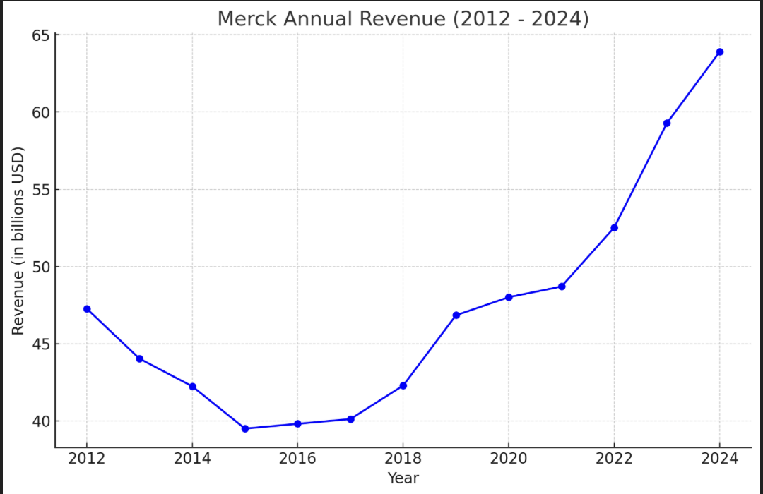

Slide 20
04
BRISTOL MYERS
Notes:
Nelson

Slide 21
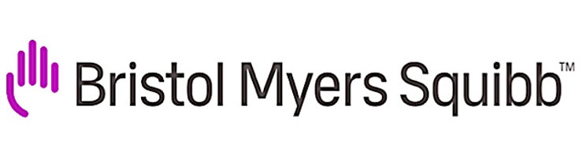
Ticker: BMY
Bristol Myers Squibb (BMS) is a global biopharmaceutical company dedicated to discovering, developing, and delivering innovative medicines that address serious diseases, with a strong focus on oncology, immunology, and cardiovascular health. What sets BMS apart from its competitors is its commitment to cutting-edge research and strategic acquisitions, such as the purchase of Celgene, which significantly expanded its oncology portfolio and reinforced its leadership in the pharmaceutical industry.
Location: New Jersey
History: Founded in 1989 from merger
Market Cap: $106.76B
Notes:
Bristol Myers founded in - 1887
Squibb founded in - 1858
Merged in 1989

Slide 22
Business Model
Recent Developments
Emphasis on R&D for new medical treatments - $10B
Partnerships with other pharma and medical companies
Focus on cardiovascular disease, oncology, and immunology
Currently developing and testing 51 new compounds
Studying over 40+ diseases to discover new treatments
R&D and manufacturing facilities around the world
Notes:
$10b in R&D in 2023
Partnerships include pfizer
Locations in US, Europe, and Asia for R&D

Slide 23
Stock Price: $52.66
PEG Ratio: 1.57
Profit Margin: -14.06%
BMS’ 52-week range is 39.35 - 55.04
BMS’ PEG Ratio indicates that the stock is overvalued
The profit margin is negative, indicating more spending on R&D
P/E Ratio: 12.66
EBITDA: $29.93B
Q3 Revenue: $11.9B
The P/E ratio is low, showing low earnings expectations
Shows the scale of Bristol Myers R&D and products
Up 8% from Q2 through increased demand in Eliquis
Notes:
Bristol myers released q3 statement today
Losing money because of competition of generic brands
Eliquis lowers the risk of stroke and blood clots

Slide 24
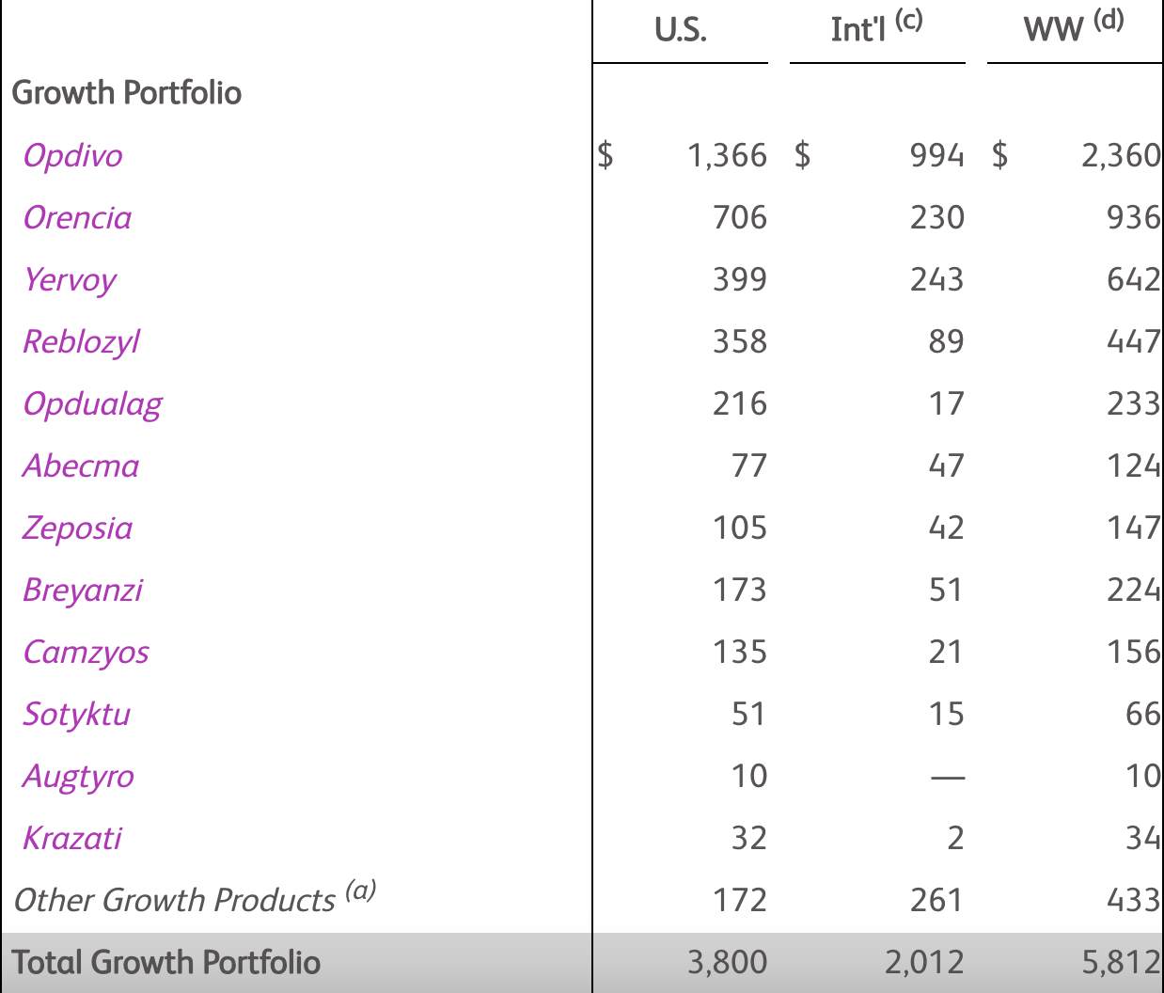
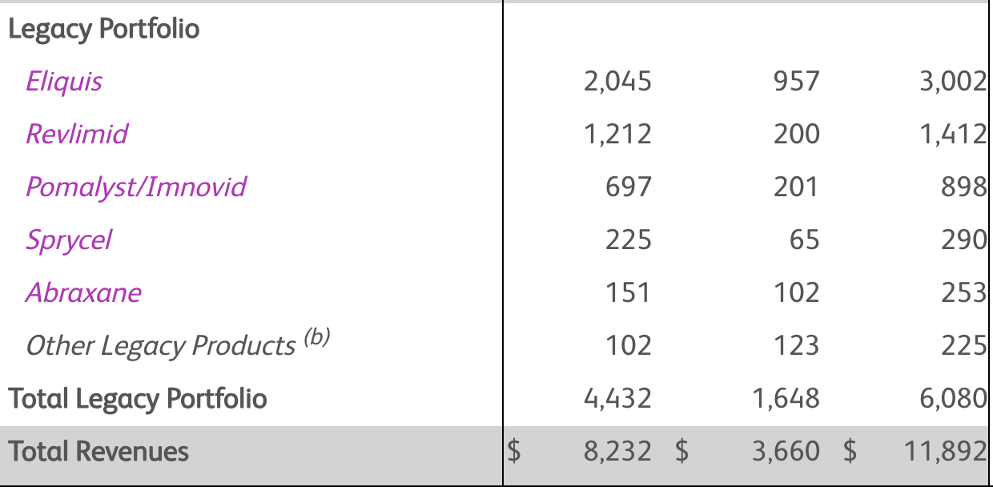
Notes:
Growth portfolio WW revenue grew to 5.8B compared to 4.9B last year at this time (up 18%)
Legacy portfolio revenues were 6.1B compared to 6B last year (up 1%)

Slide 25
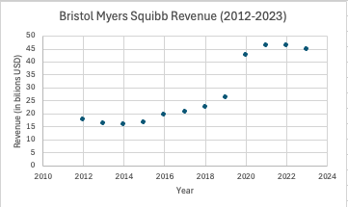
Notes:
Spike in revenue due to oncology drugs due to the Celgene acquisition

Slide 26
05
COMPARISONS
Notes:
Rida

Slide 27
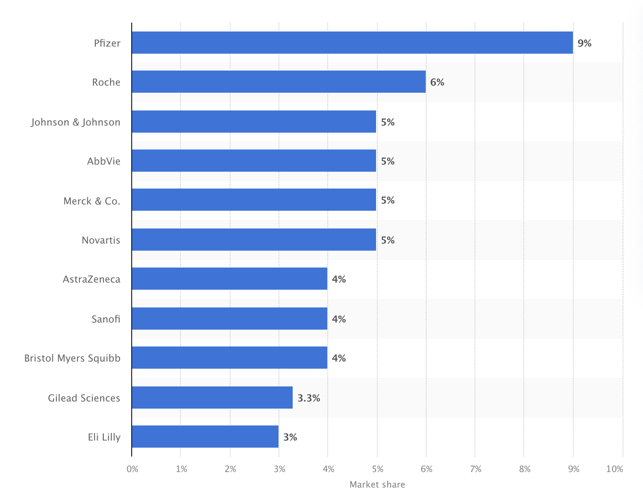
MARKET SHARE

Slide 28
 | PFE | MRK | BMY
Market Value | 161.61B | 265.72B | 106.76B
P/E Ratio | 38.03 | 19.41 | 12.66
Revenue Growth YoY | 2.13% | 7.16% | 8.69%
Gross Profit | 31.65B | 47.02B | 35.06B
Free Cash Flow (FCF) | 4.81B | 13.15B | 12.95B
Profit Margin | -4.70% | 18.9% | -14.06%
Return on Assets | -1.19% | 12.65% | -6.95%
Notes:
Revenue, PE ratio, R&D investments

Slide 29
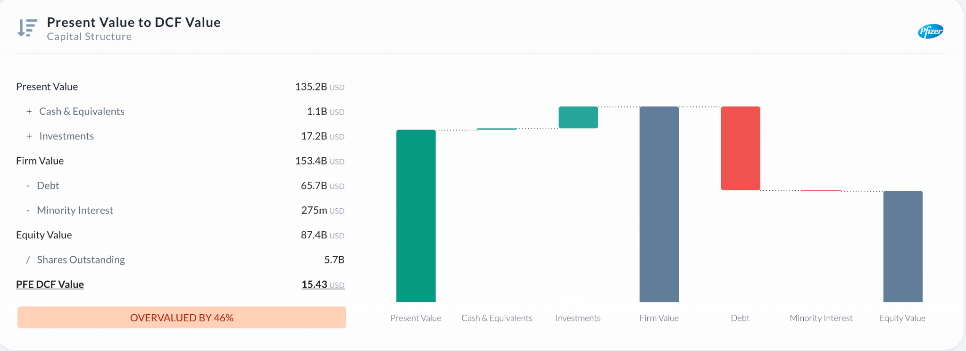
Notes:
Some sort of graph to compare

Slide 30
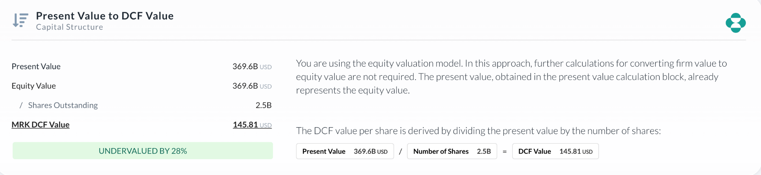
Notes:
Some sort of graph to compare

Slide 31
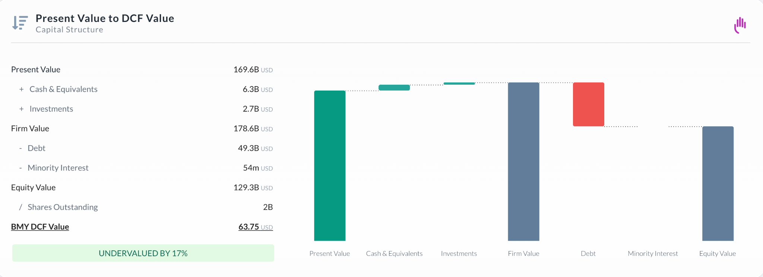
Notes:
Some sort of graph to compare

Slide 32
06
OUR PICK
Notes:
Brody

Slide 33
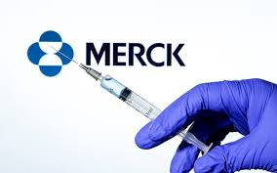
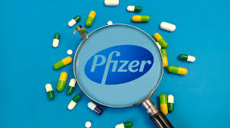
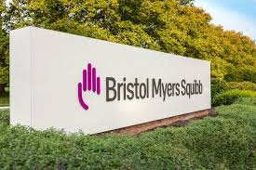
Pfizer - 2nd Place
Merck - 1st Place
Bristol Myers - 3rd Place

Slide 34
Thanks! Any Questions?
The Cash Cows

